Slide 1

Introduction to remote sensing
VET course
SADL
KU Leuven

Slide 2
Table of content
Remote sensing
The electromagnetic spectrum
Visualisation of collected data
Spectral signature
Image properties
Satellite data sources
Explore

Slide 3
Learning objectives
At the end of the course the participants should be able:
To explain what remote sensing is
To explain the difference between EO & RS
To differentiate & compare different RS sensors
To describe and discuss different types of resolution
Discuss RS methods
Explain the electromagnetic spectrum in the context of RS
Identify the main features of satellites that determine their capabilities

Slide 4
Remote sensing
1

Slide 5
Earth observation
Earth observation refers to the collection of information about the Earth’s physical, chemical, and biological systems through various means:
Satellite imaging
Areal photography
Ground-based measurements
…
Notes:
How are Earth Observation and Remote Sensing Different? | New Space Economy
Earth observation: How does it work? (youtube.com)

Slide 6
What is remote sensing?
Remote sensing is the collection of information about an object or phenomenon without making physical contact with the object.
The sensors must be in some distance from the object.
In our case the object an area of the Earth surface and the sensor is measuring electromagnetic radiation leaving the Earth from a satellite platform.
Specifically: the use of satellites to gather information about the Earth’s surface and atmosphere

Slide 7
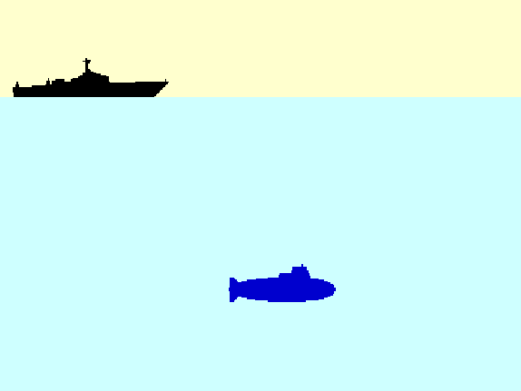
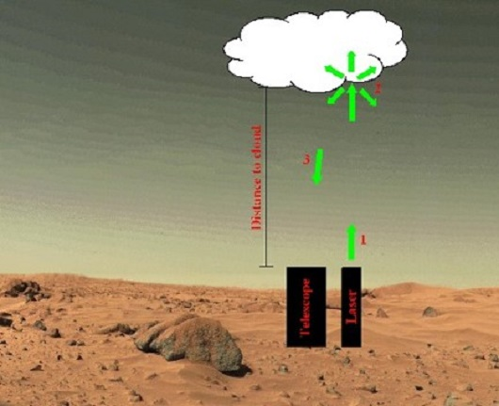
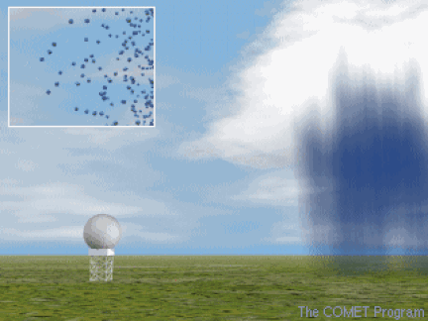
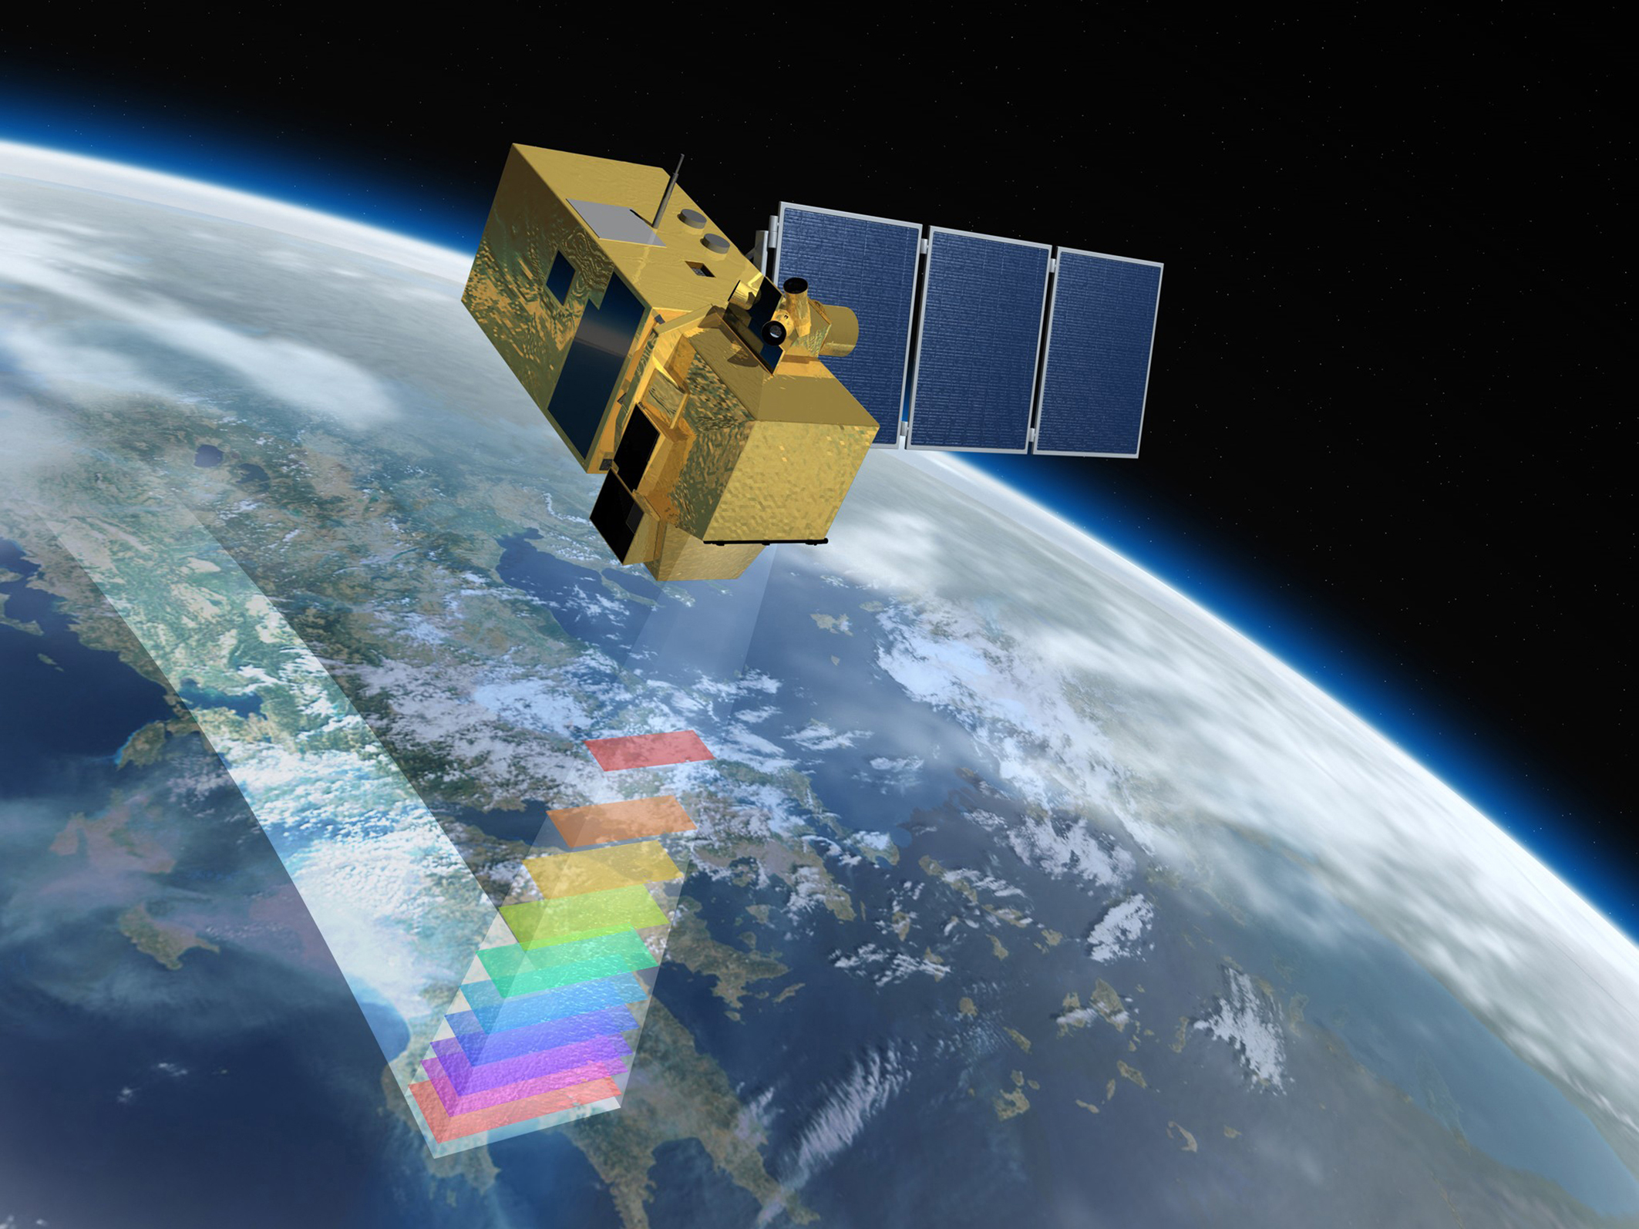
EO vs RS
All remote sensing is a form of earth observation, not all earth observation is remote sensing.

Slide 8
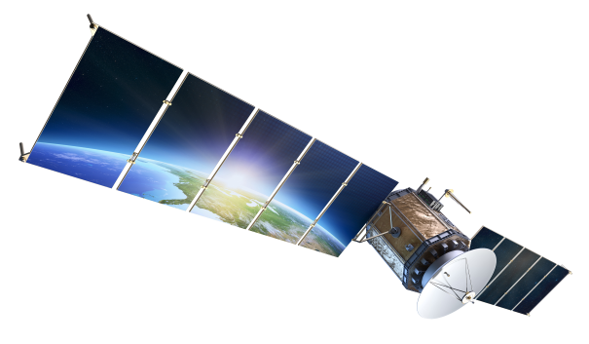
FreeIconsPNG, n.d.
Notes:
FreeIconsPNG. (n.d.). High Quality Satellite Cliparts For Free! PNG Transparent Background, Free Download #40927 [Image]. FreeIconsPNG. https://freeiconspng.com

Slide 9
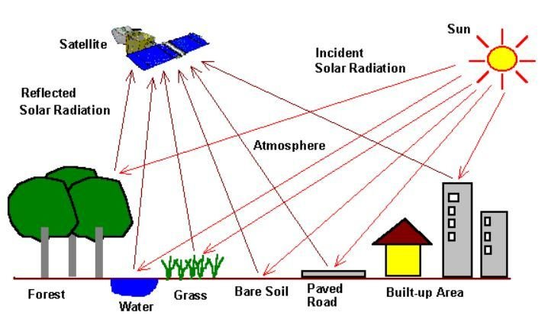
What data does a satellite collect?
The remote sensor samples emitted, reflected or scattered electromagnetic radiation (EMR).

Slide 10


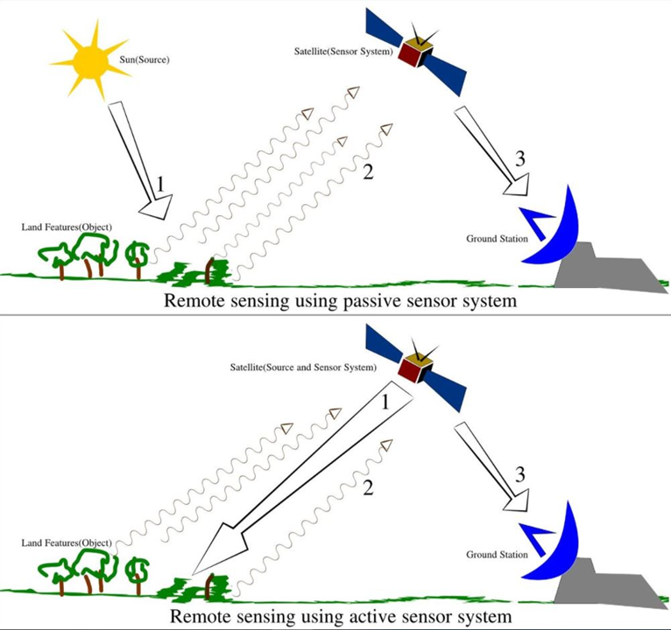
Types of sensors
Passive Sensor: detects natural energy (radiation) that is emitted or reflected by the object.
Reflected sunlight is the primary source of radiation measured by passive sensors
Active Sensor: generates energy in order to scan objects and areas. The sensor measures the amount of energy returned from the target
e.g. synthetic-aperture radar (SAR).

Slide 11
The electromagnetic spectrum
2

Slide 12
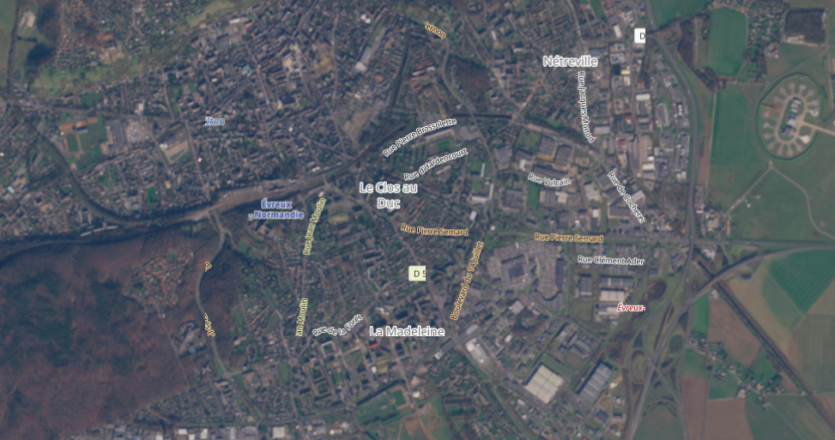
Notes:
Copernicus. (n.d.). Copernicus Browser [Image]. European Union, Copernicus Data Space Ecosystem. https://browser.dataspace.copernicus.eu/

Slide 13
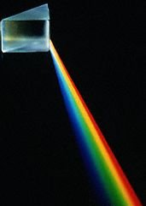
The electromagnetic spectrum
The visible part

Slide 14
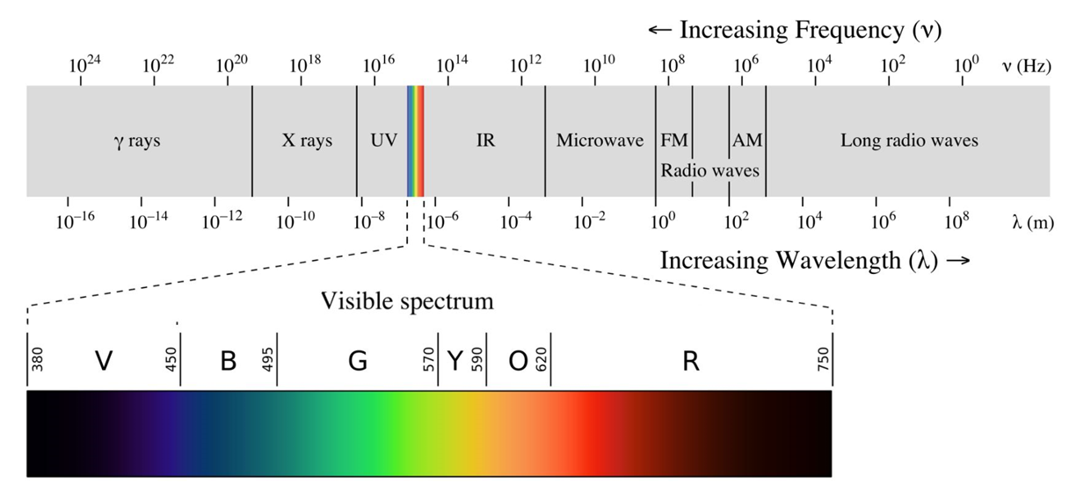
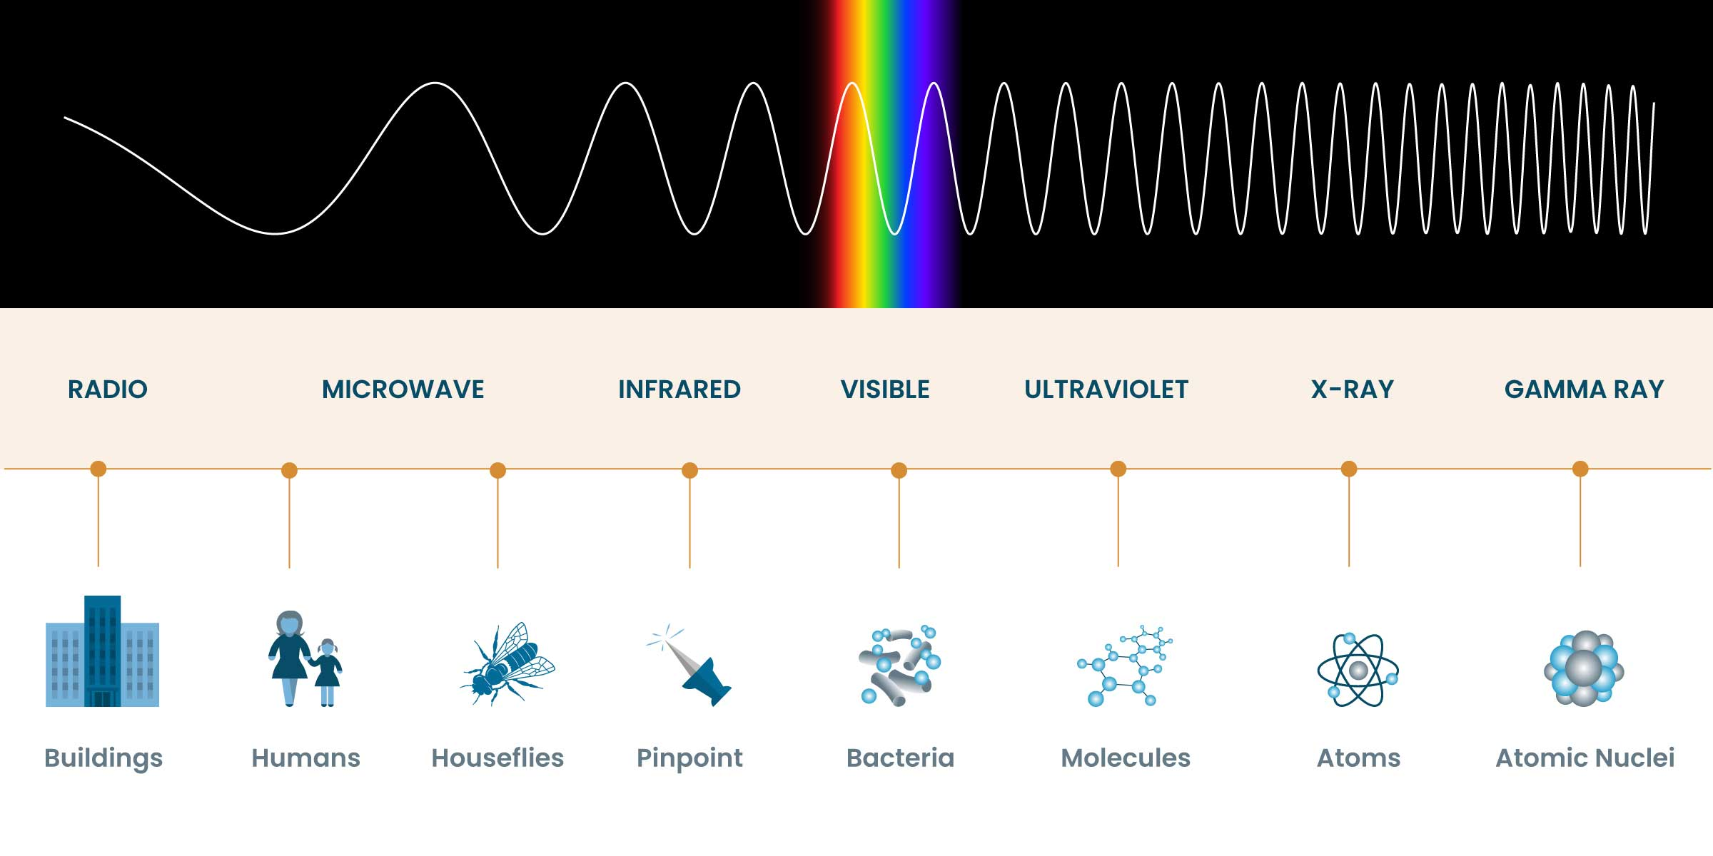
The electromagnetic spectrum
Electromagnetic radiation is classified by wavelength into gamma rays, X-rays, ultraviolet, visible, infrared, microwave and radio.
Optimus Medica, n.d.
Notes:
Optimus Medica. (n.d.). Electromagnetic spectrum [Image]. Optimus Medica. https://www.optimusmedica.com/definition/electromagnetic-spectrum/

Slide 15
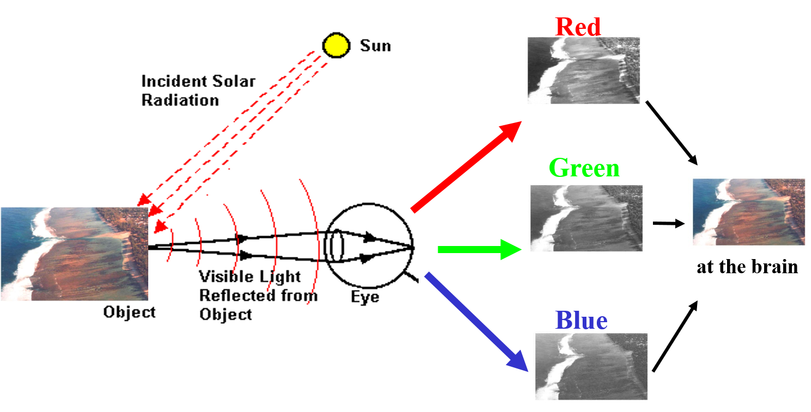
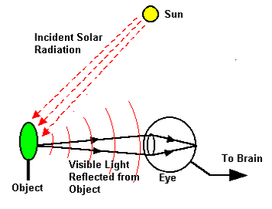
Analogy with out eyes

Slide 16
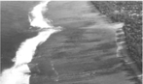
Satellite
e.g. NIR

Slide 17
Visualisation of collected data
3

Slide 18
How to show collected information

Slide 19
Satellite
e.g. NIR
BANDS

Slide 20
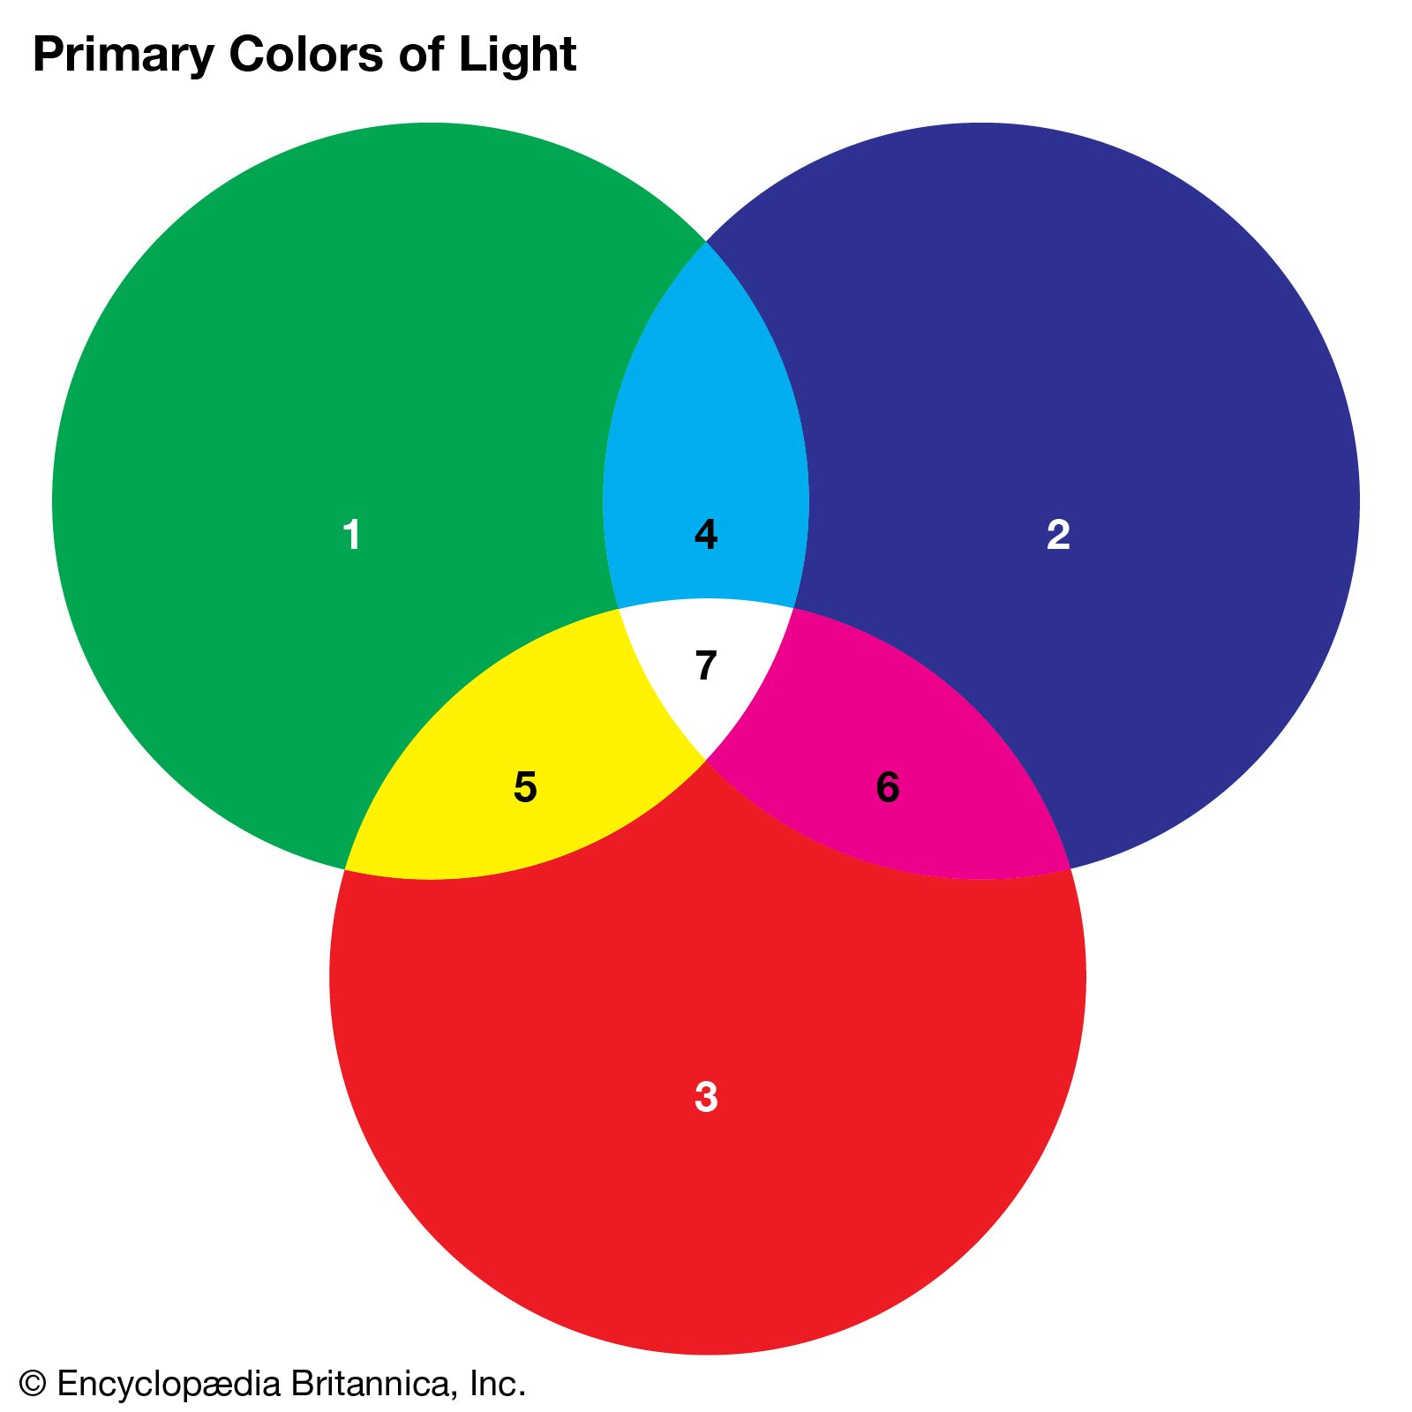
Primary colours: RGB
%
%
%
Notes:
Encyclopaedia Britannica. (n.d.). Primary color. In Britannica. Retrieved [today’s date in Month Day, Year format], from https://www.britannica.com/science/primary-color

Slide 21
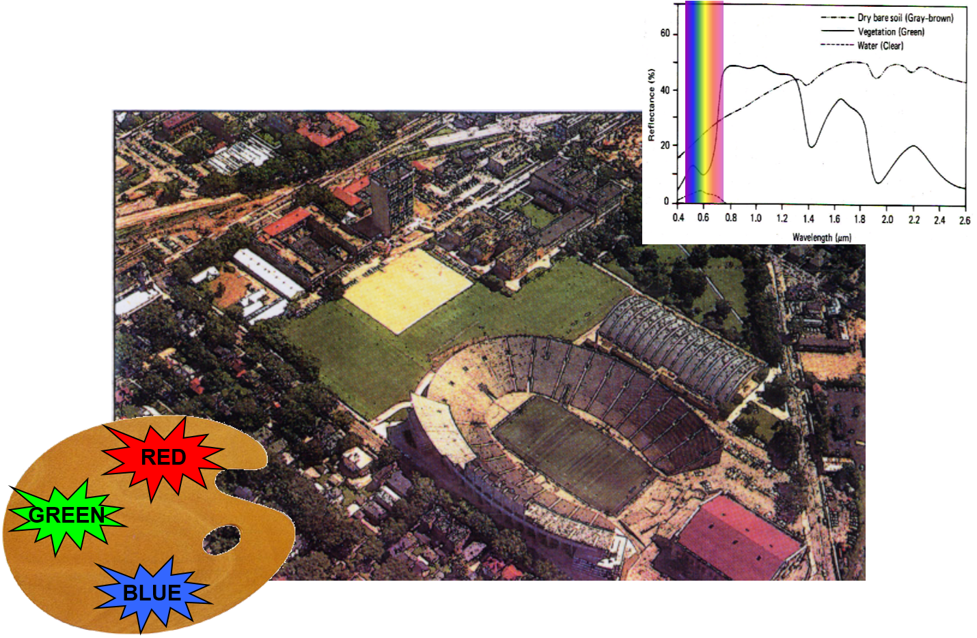
True colours: true colour composite

Slide 22
Representing other bands
Optimus Medica, n.d.

Slide 23
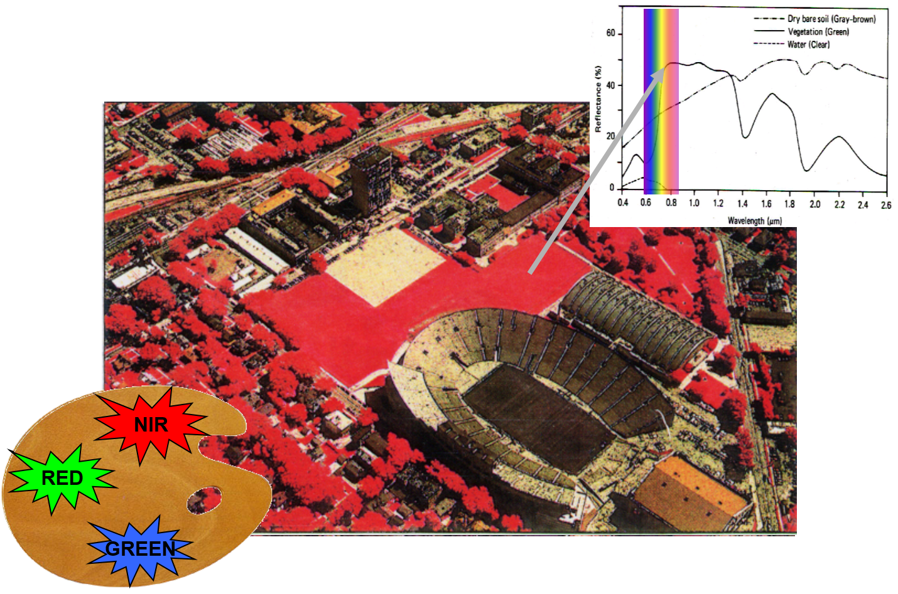
IR: False colour composite
Notes:
Why?

Slide 24
Spectral signature
4

Slide 25
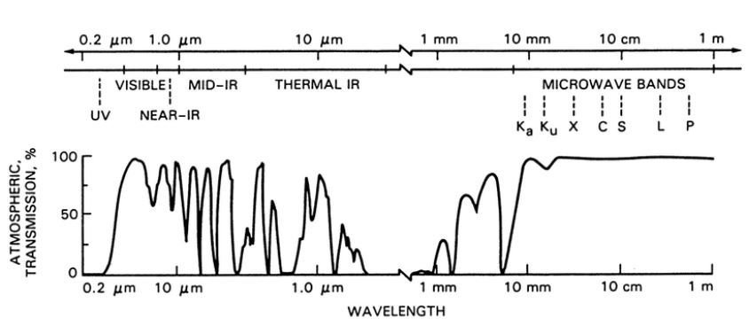
Atmospheric interactions
Electromagnetic radiation passing through the atmosphere interacts with gas molecules and particulate matter.
Effects of interaction:
Absorption by gases like water vapor, CO2, O3
Scattering depends on the wavelength and dimensions of particles
Atmospheric windows is the area of spectrum not severely influenced by the atmosphere.

Slide 26
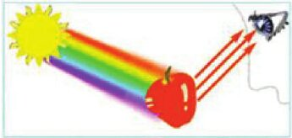
Interaction object-light
Abu Hassan, Yusof, Azmi, & Mazli, 2012
Notes:
M. F. Abu Hassan, Y. Yusof, M. A. Azmi, M. N. Mazli. (2012). Fuzzy Logic Based Intelligent Control of RGB Colour Classification System for Undergraduate Artificial Intelligence Laboratory. Proceedings of the World Congress on Engineering 2012 Vol II WCE 2012, July 4 - 6, 2012, London, U.K.

Slide 27
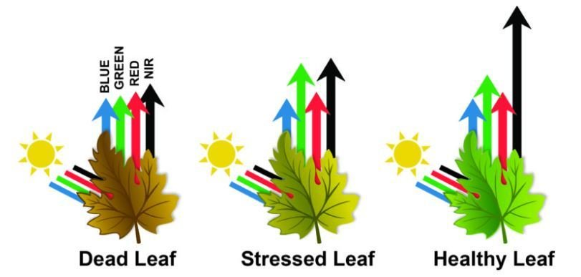

What can this reflection tell us?
Radiation can be absorbed by a target, transmitted through a target or reflected. The proportion of each depends on the wavelength and surface features.
Vecteezy, n.d.
Notes:
Vecteezy. (n.d.). Green leaf simple colored vector icon isolated on white square background: Simple flat outline cartoon vector icon drawing with natural leaf and botanical theme [Vector image]. Vecteezy. https://www.vecteezy.com/vector-art/24444471-green-leaf-simple-colored-vector-icon-isolated-on-white-square-background-simple-flat-outline-cartoon-vector-icon-drawing-with-natural-leaf-and-botanical-theme

Slide 28
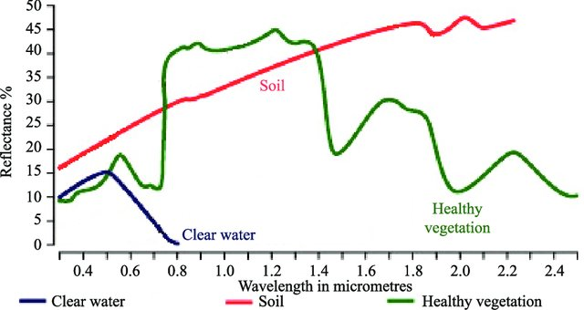
Spectral signature
Spectral reflectance curve
Spectral Reflectance is the amount of energy reflected from a surface at a specific wavelength.
Analysis of the spectral reflectance signatures
allows to distinguish different surface feature
or materials.
Spectral reflectance curve presents the
reflectance of objects as a function of wavelengths.
Kumar & Reshmidevi, 2019
Notes:
Kumar, D. N., & Reshmidevi, T. V. (2019). Reviews: Remote sensing applications in water resources. ResearchGate. https://www.researchgate.net/publication/330396782_Reviews_Remote_Sensing_Applications_in_Water_Resources

Slide 29
Spectral signature
There are even spectral library's, as each material has a specific signature.
However these are often in lab condition, but you can use the concept to make them for the context of your images: training
e.g. ECOSTRESS Spectral Library - Version 1.0

Slide 30
Image properties
5

Slide 31
Resolutions
5.1

Slide 32
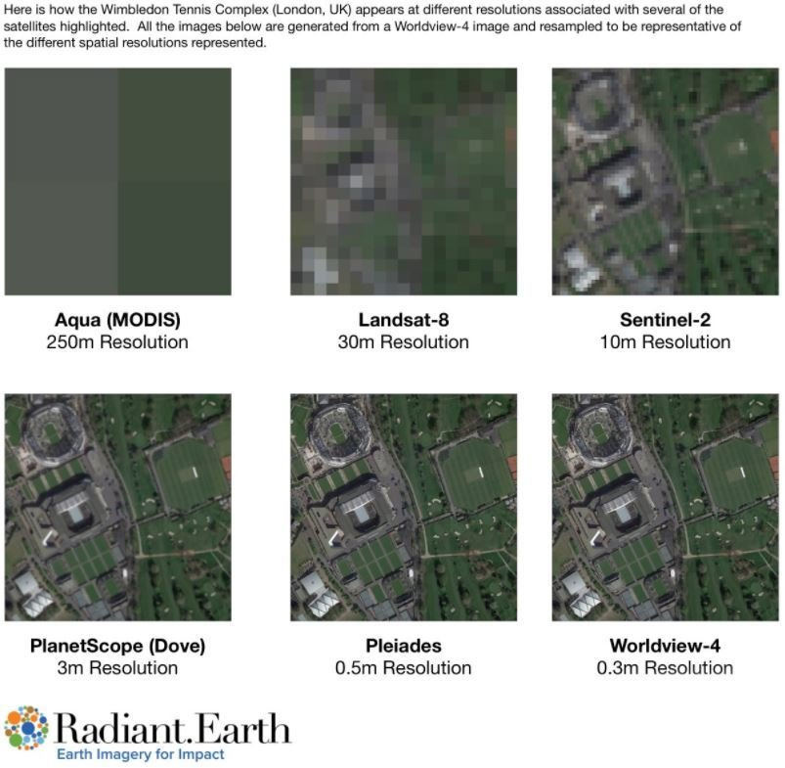
Spatial resolution
The size of the smallest area observed on the ground (ground resolution cell)
Importance:
Object is usually detectable if it is equal or larger than the pixel size.
The smaller objects could be still detectable as the average brightness of all objects within the pixel.

Slide 33
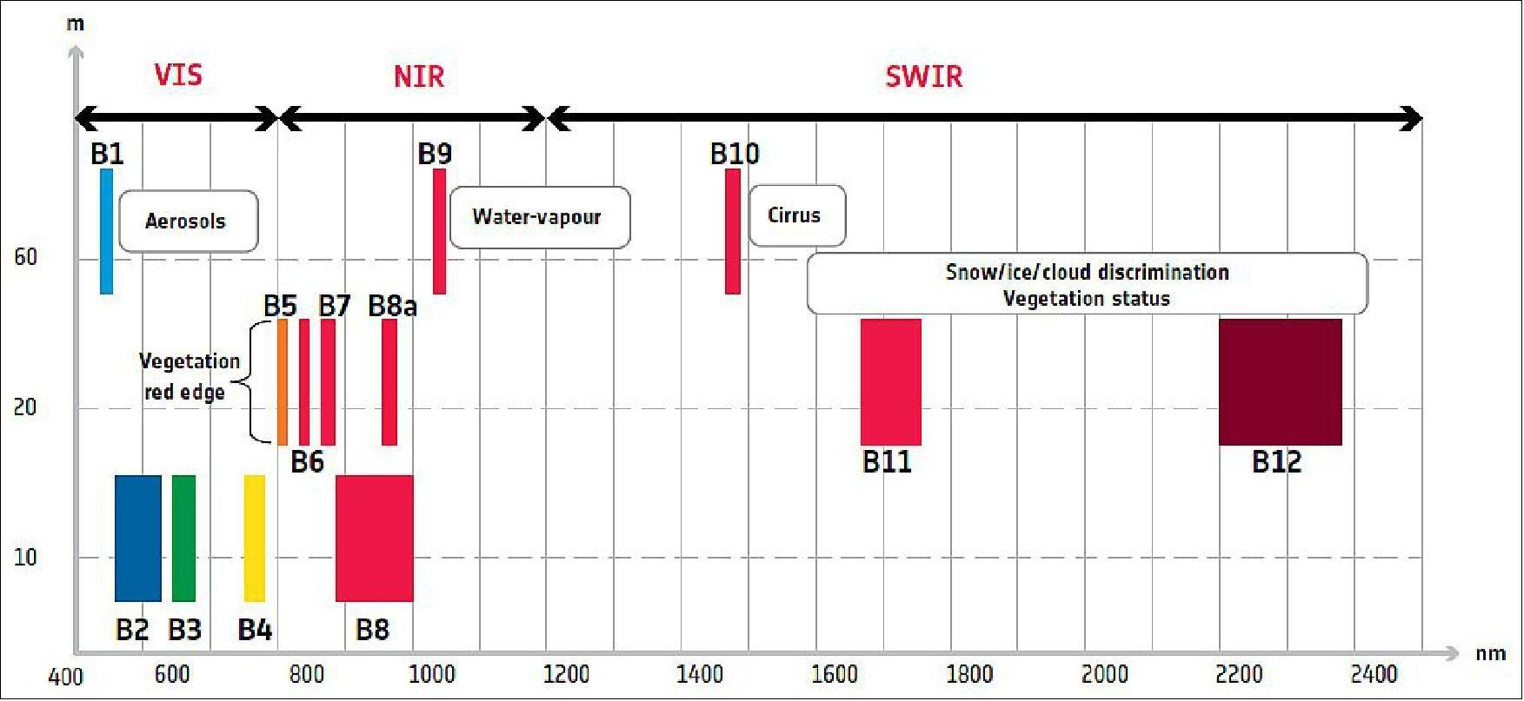
Spectral resolution
Refers to:
the spectral bandwidth
the number of bands.
The finer spectral resolution, the narrower the wavelength range for the particular band.

Slide 34
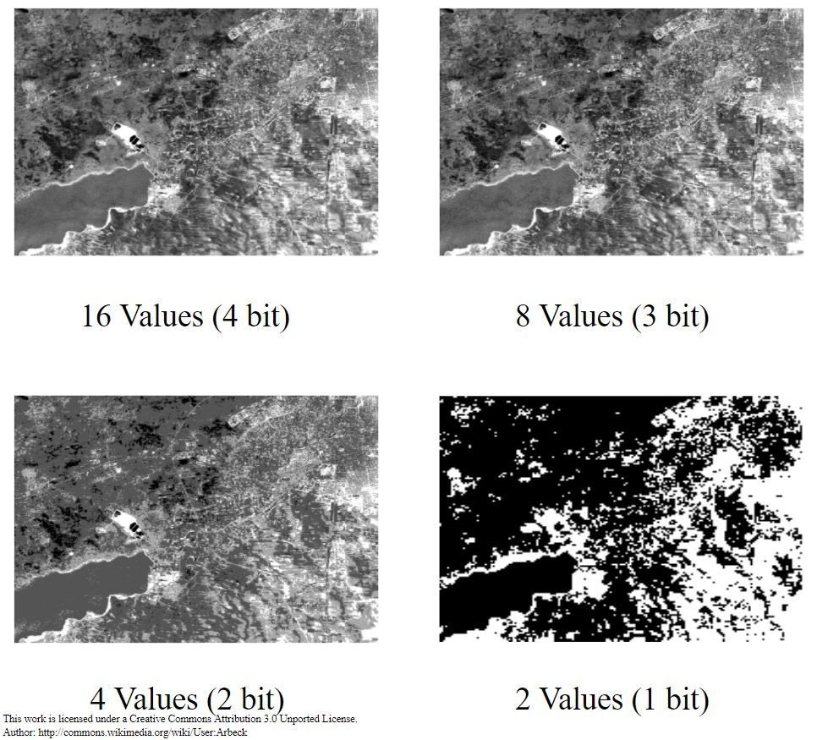
Radiometric resolution
The sensitivity to the magnitude of the electromagnetic energy. It describes the actual information content in an image, expressed in units of bits.
The finer the radiometric resolution, the more sensitive it is to detect small differences in reflected or emitted energy.

Slide 35
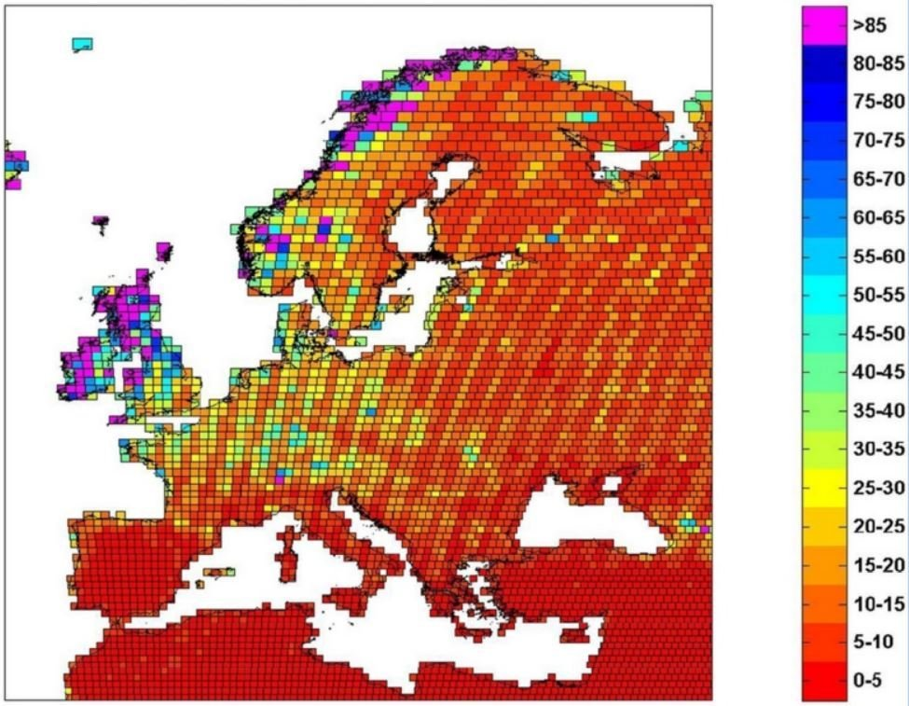
Temporal resolution
Frequency at which the same place is observed - revisit capability
Depends on the path of the satellite
Examples:
NOAA = 1 day
Landsat = 16 days
Sentinel-2 = 5 days
It is particularly important for change mapping.

Slide 36
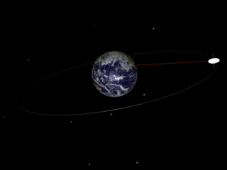
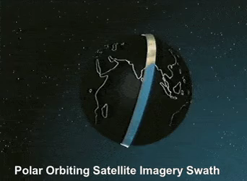
Temporal resolution
Satellite paths
Geostationary/ geosynchronous orbit Polar orbit
Notes:
Fayil:Geosynchronous orbit.gif – Wikipedia
geosynchronous orbits are often referred to as geostationary if they are roughly over the equator, but the terms are used somewhat interchangeably.
Whole-Globe Coverage with Polar Satellite : r/physicsgifs (reddit.com)

Slide 37
Level of pre-processing
Level 0
unprocessed instrument/payload data at full resolution
most raw format available
Level 1A
- reconstructed, unprocessed instrument data at full resolution, time-referenced
annotated with ancillary information including radiometric and geometric calibration coefficients and georeferencing parameters (e.g. platform ephemeris data) computed and appended
Level 1B
Level 1B data are Level 1A data that have had instrument/radiometric calibrations applied
Level 2
consist of derived (by the l2gen program) geophysical variables at the same resolution as the source Level 1 data
variables are grouped into a few product suites (e.g. OC [ocean color], SST, and SST4 for MODIS).
Level 3
- derived geophysical variables that have been aggregated/projected onto a well-defined spatial grid over a well-defined time period

Slide 38
Satelitte data sources
6

Slide 39
Some online viewers
EarthExplorer (usgs.gov)
https://eos.com/landviewer/
Sentinel Hub EO Browser (sentinel-hub.com)

Slide 40
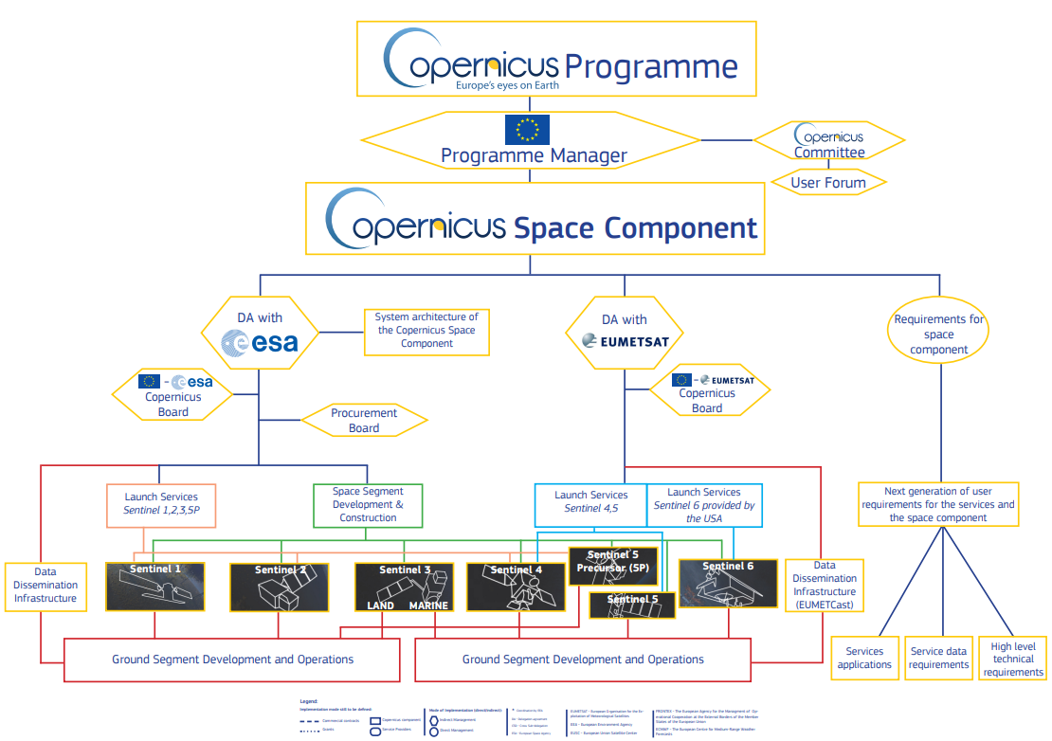
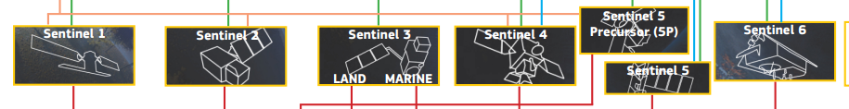
Copernicus
Earth observation component of the European Union’s Space programme
looking at our planet and its environment to benefit all European citizens
offers information services that draw from satellite Earth Observation and in-situ (non-space) data
Space component:

Slide 41
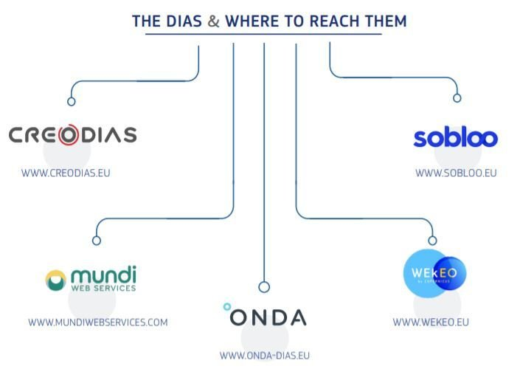
DIAS
To facilitate and standardise access to data, the European Commission has funded the deployment of five cloud-based platforms called DIAS providing centralised access to Copernicus data and information, as well as to processing tools.
All DIAS platforms provide access to Copernicus Sentinel data, as well as to the information products from Copernicus’ six operational services, together with cloud-based tools (open source and/or on a pay-per-use basis).

Slide 42
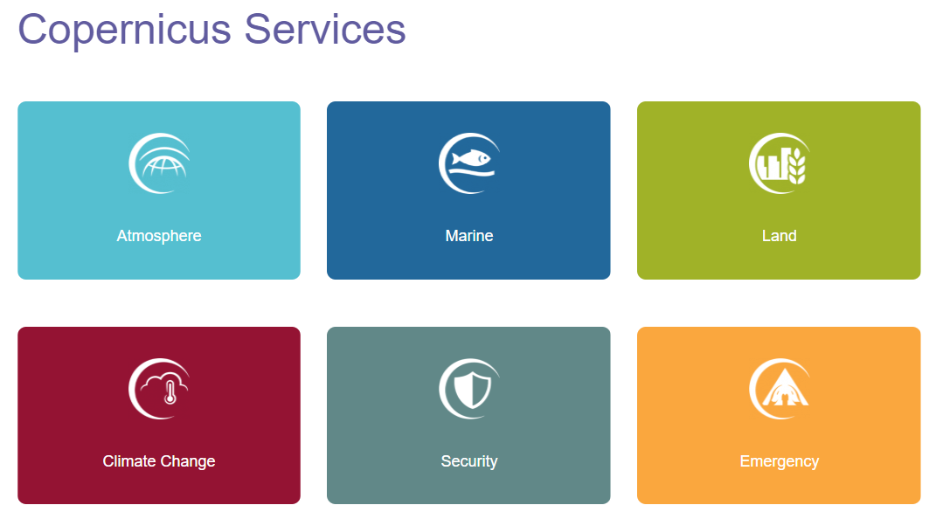
Copernicus services
Satellite data → value added information
Grouped by theme:
Notes:
Zeker tonen

Slide 43
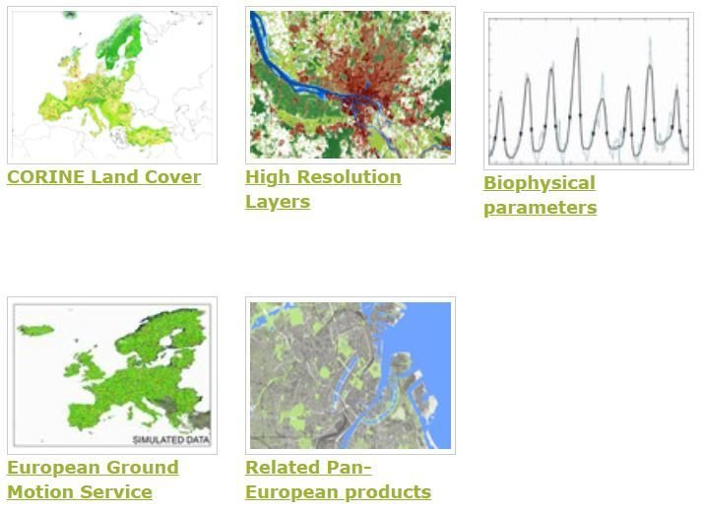
CLMS Pan-European component
CLMS portfolio — Copernicus Land Monitoring Service
CLMS: Copernicus Land Monitoring Service
CORINE Land Cover (CLC) inventory was initiated in 1985 (reference year 1990), Updates: 2000, 2006, 2012 & 2018
High Resolution Layers (HRL) provide information on specific land cover characteristics, and are complementary to land cover/land use (LC/LU) mapping such as in the CORINE land cover (CLC) datasets
HRL Imperviousness Density and Changes

Slide 44
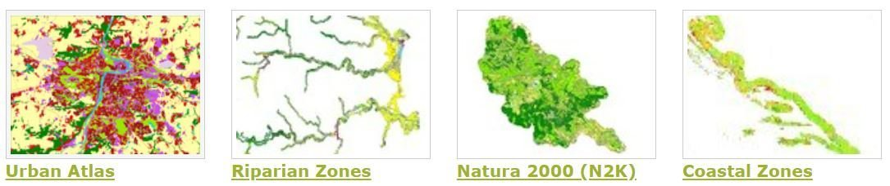
CLMS Local Component
Local component aims to provide specific and more detailed information that is complementary to the information obtained through the Pan-European component.
There focuses on different hotspots, i.e. areas that are prone to specific environmental challenges and problems. It is based on very high-resolution imagery (2,5 x 2,5 m pixels) in combination with other available datasets over the pan-European area.

Slide 45
CLMS Local Component
Examples:
Urban Atlas 2006, 2012 and 2018; 785 Functional Urban Areas (FUA) covering EU28 + EFTA countries + West Balkans + Turkey
Riparian Zones (RZ) represent transitional areas occurring between land and freshwater ecosystems, characterised by distinctive hydrology, soil and biotic conditions and strongly influenced by the stream water.
The LC/LU classification is tailored to the needs of biodiversity monitoring in a variable buffer zone of selected rivers (Strahler levels 2-9 derived from EU-Hydro)
LC/LU classes follow the pre-defined nomenclature on the basis of Mapping and Assessment of Ecosystems and their Services (MAES) typology of ecosystems (Level 1 to Level 4) and Corine Land Cover
Natura 2000 (N2K): reference year 2000 and 2006
55 Land Cover/Land Use classes
A selection grassland-rich sites (chosen within five grassland habitats types: 6210, 6240, 6250, 6510 and 6520). Approx. 630.000 km2 including a 2km buffer to allow for an analysis of pressures and threats

Slide 46
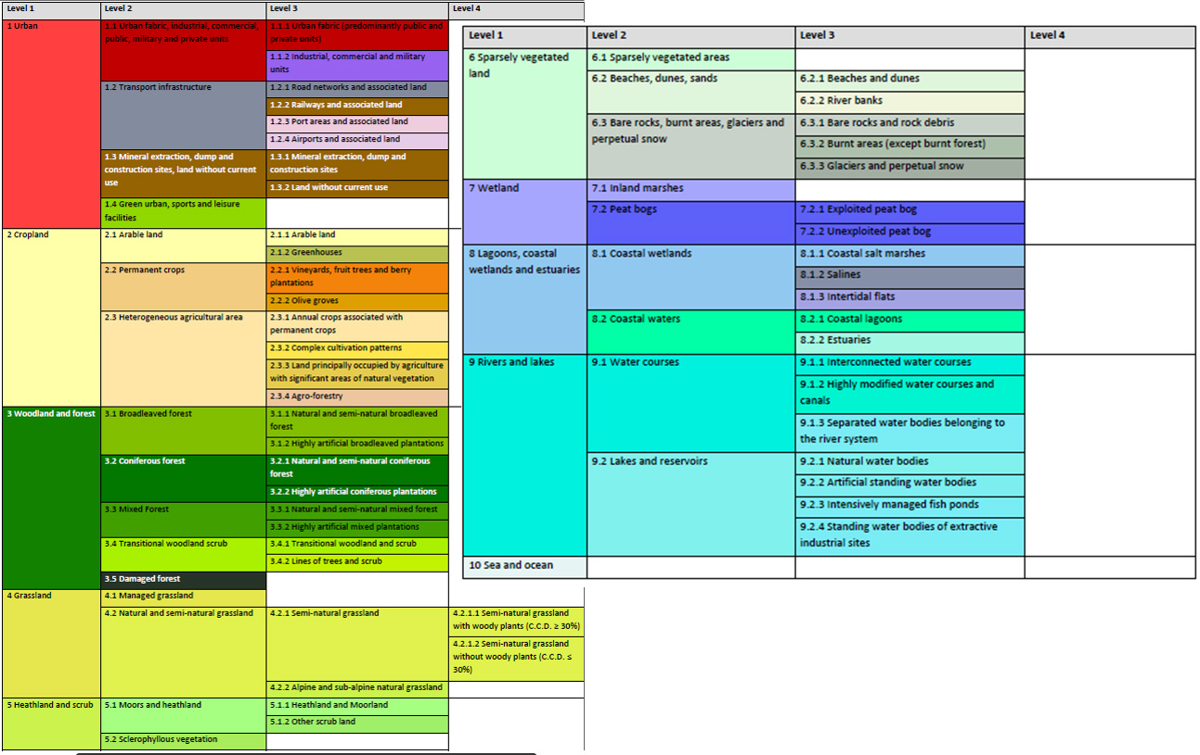
CLMS Local Component
Riparian Zones and Natura2000
nomenclature for Land Cover/
Land Use

Slide 47
CLMS Local Component
Examples:
Coastal Zones
reference year 2012 and 2018
Coastal Zones changes 2012 – 2018
71 Land Cover/Land Use classes
MMU = 0.5 ha
MMW = 10 m
The map covers a buffer zone of coastline derived from EU-Hydro. LC/LU is extracted from Very High Resolution (VHR) satellite data and other available data. The class definitions follow the pre-defined nomenclature on the basis of Mapping and Assessment of Ecosystems and their Services (MAES) typology of ecosystems (Level 1 to Level 4) and CORINE Land Cover adapted to the specific characteristics of coastal zones.

Slide 48
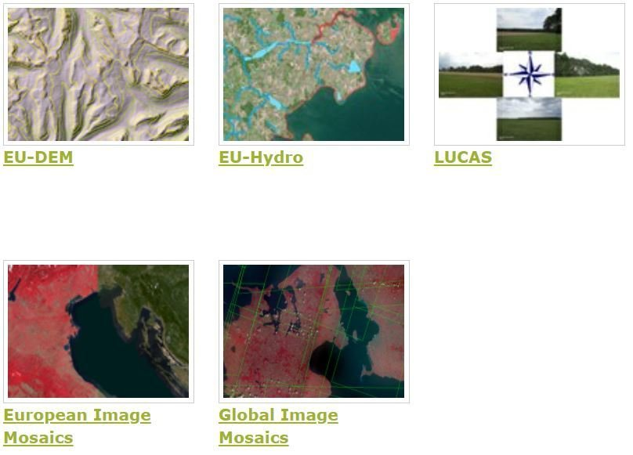
CLMS Imagery and reference data
Copernicus land services need both satellite images and in-situ data in order to create reliable products and services.
EU-DEM – pan European digital surface model and EU-Hydro provides a photo-interpreted river network and a modelled drainage network for EEA39 countries.

Slide 49
Explore
7

Slide 50
Explore
https://browser.dataspace.copernicus.eu/
Copernicus Services | Copernicus (LAND)
CLMS portfolio — Copernicus Land Monitoring Service

Slide 51
Source
This course is based on EO4GEO content:
Hościło, A., Tramutoli, V., Capece, N., & Satriano, V. (n.d.). Introductory exercise course to remote sensing. EO4GEO. http://www.eo4geo.eu/training/introductory-exercise-course-to-remote-sensing/

